Slide 1
Containers Everywhere in Azure!
Jordan Bean and Matt Ruma

Slide 2

Recording Session is in Progress
If you prefer us not to include you in the recording, please drop off now.

Slide 3
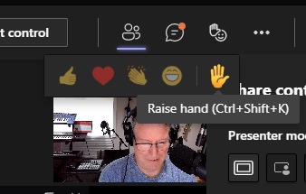

Questions during the session
Ctrl+Shift+K is a quick way to raise or lower your hand
In a regular teams meeting, please use the “Raise Your Hand” feature if you want to ask a question versus posting it in the chat window

Slide 4
Microsoft Confidential

Slide 5


Welcome to
Microsoft SPARK FY22H2!
For the field, by the field
Microsoft SPARK is a virtual learning conference open to all Microsoft internal employees, with a target audience of field individual contributors in Services, Sales and Support. Join us for your choice of 700+ peer led learning sessions across 7 solution areas and 66+ tracks – There is truly something for everyone!
This is an opportunity to exercise a growth mindset, learn with your peers, build connections across time zones, and hear new perspectives and solutions. Content will include delivery management, technical sessions (100-400+ level), diversity and inclusion topics, engineering releases, industry specific sessions, VIP speakers and much more.
For more information on additional sessions, content recordings, and slide decks, visit http://aka.ms/MicrosoftSPARK

Slide 6
Session Learning Objectives
At the end of this session, you should be better able to…
Containerize .NET Core apps
Deploy containers to various hosting options in Azure using GitHub Actions
App Services for Containers
Azure Container Instances (ACI)
Azure Kubernetes Service (AKS)
Azure Container Apps (ACA)
Choose the right hosting option for your containers
Notes:
This slide is required. Do NOT delete. This should the first slide in your presentation after your session opening.
This slide should be part of your session opening and introduce what the learner will be better able to do as a result of attending this session.
You should have no more than 3 learning objectives for your session. Best practice: 1 Learning objective for 60 minute session. Aim for depth vs. breadth.
Good learning objectives should be learner centric, start with a verb (e.g., articulate, demonstrate, deliver, architect, troubleshoot, design) and be S.M.A.R.T (specific, measurable, achievable, realistic, time-bound). The learning objective should define a desired learner behavior (NOT what you are going to present).
The learning objectives on this slide should match those defined and published for your session on the SPARK session submission form.

Slide 7

Background
BoardGameNerd is an online resource and community that aims to be the definitive source for board game and card game content.
BoardGameNerd features reviews and ratings from board game nerds around the world.
BoardGameNerd would like to get a better understanding of what it would take to containerize their applications and explore container hosting options in Azure.

Slide 8
Objectives
Review current application architecture
Containerize .NET Core applications
Deploy to Azure Container Registry (ACR)
Explore Azure hosting options for containers
App Services for Containers
Azure Container Instances (ACI)
Azure Kubernetes Service (AKS)
Azure Container Apps (ACA)
Azure Virtual Machines
Azure Batch
Azure Service Fabric
Choose the right container hosting option

Slide 9
Current Architecture
Current environment hosted in Azure
Apps running on Azure App Services
App settings
API endpoint
Application Insights
Why containers? We were told to do it. New hotness.

Slide 10




Current environment hosted in Azure
Server
BoardGameGeek JSON API
Internet
App Service
Plan
Client
Application
Insights
Diagnostics Logs
Notes:
Future version may leverage Key Vault for storing secrets and Azure API Management to put in front of the BoardGameGeek APIs.

Slide 11
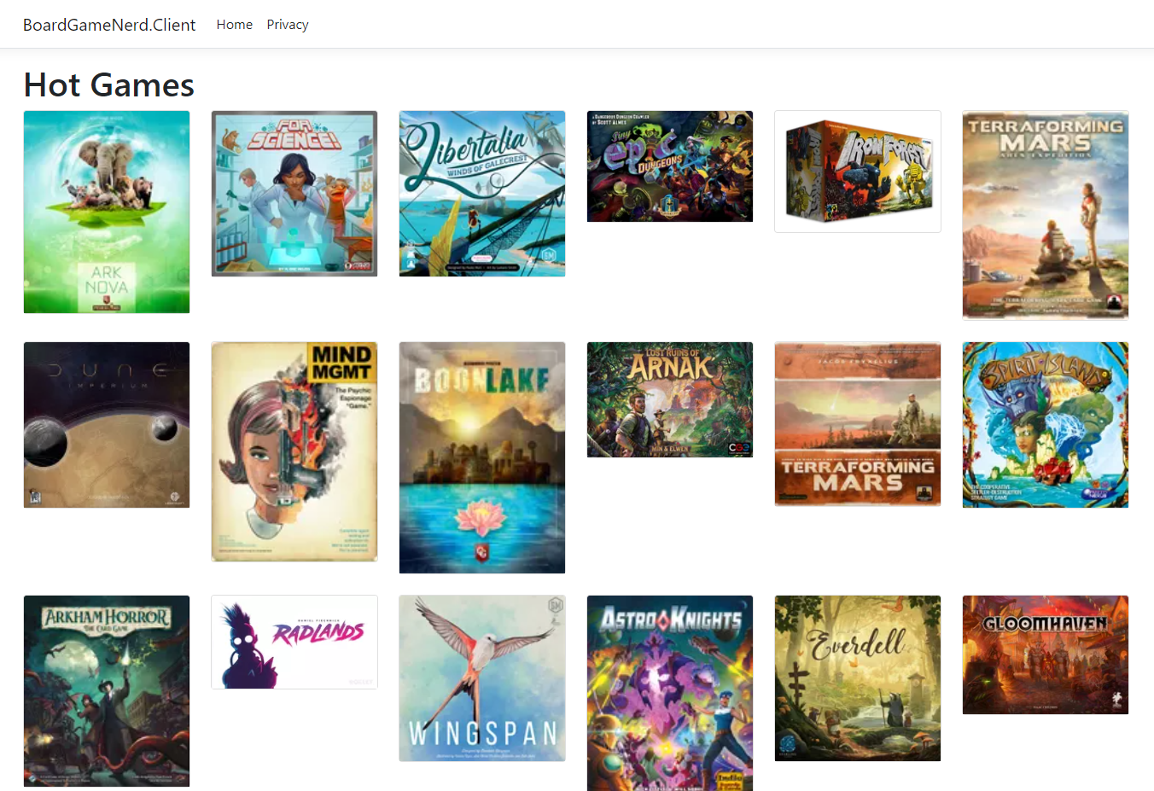
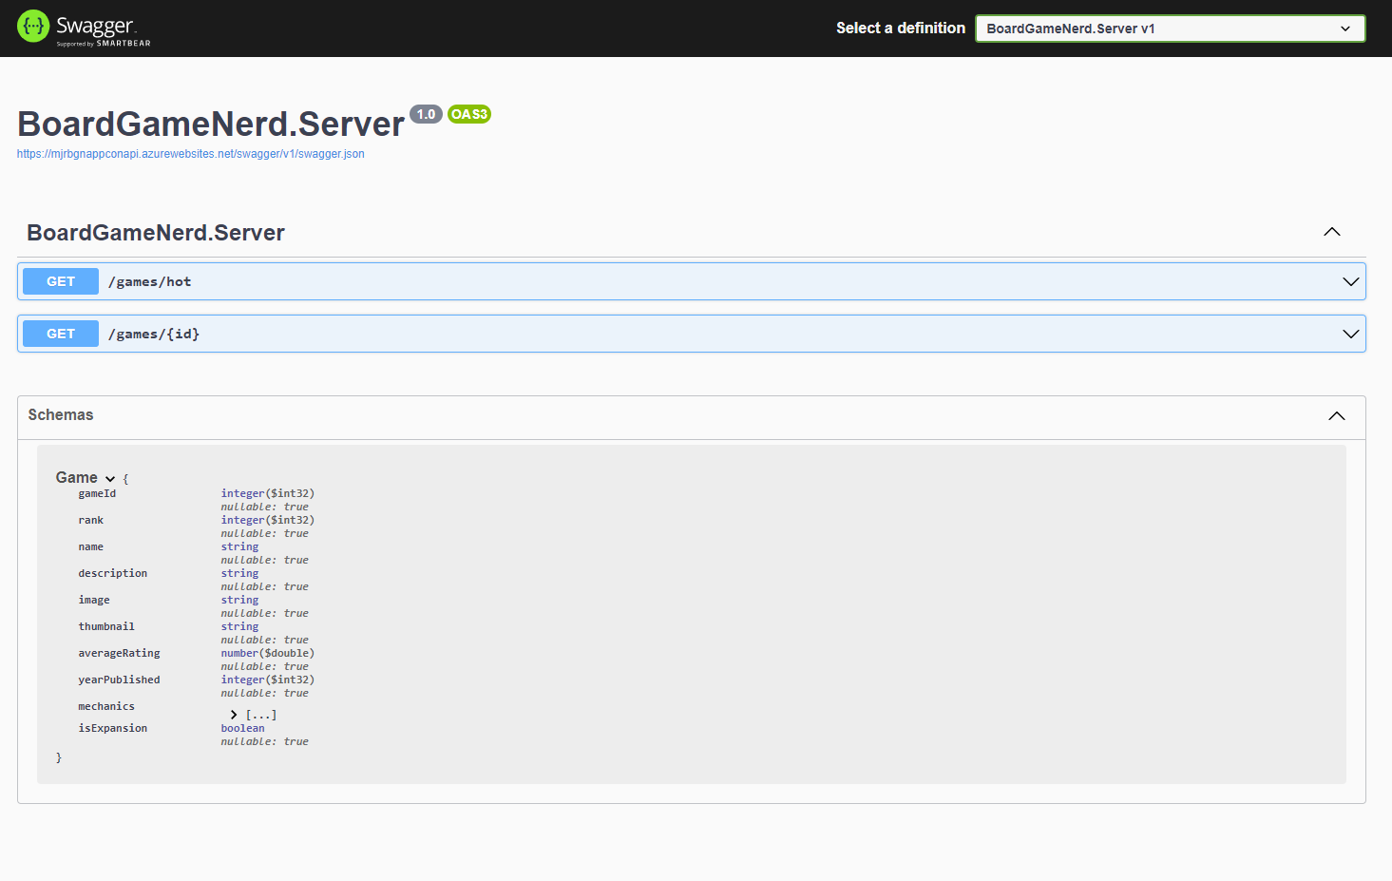
Apps running on Azure App Services
https://mjrbgnappconapi.azurewebsites.net/swagger/index.html
https://mjrbgnappapp.azurewebsites.net/

Slide 12
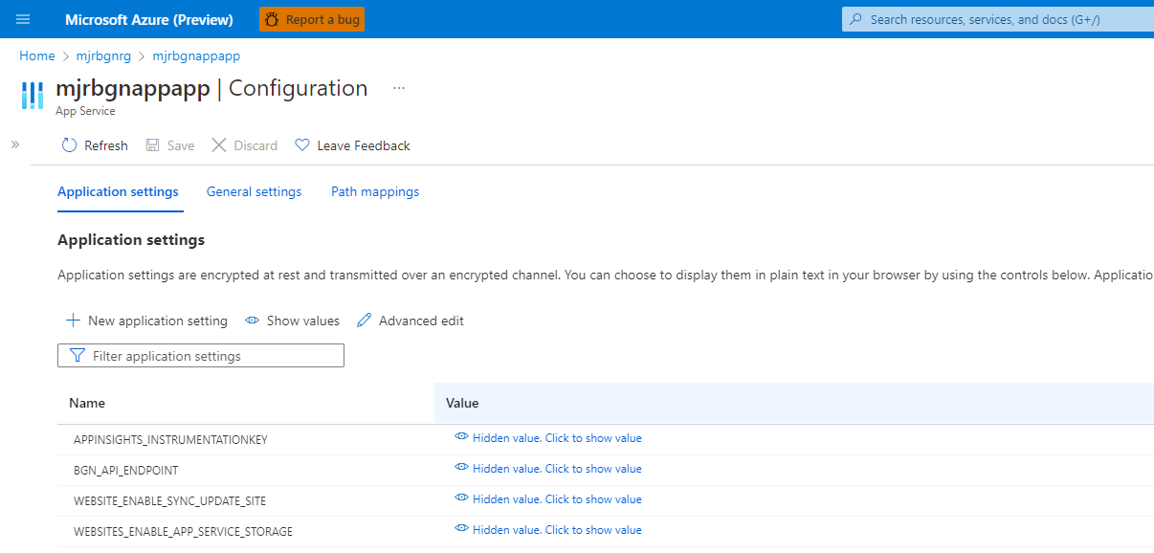
App settings
Notes:
Client has an APPINSIGHTS_INSTRUMENTATIONKEY settings for the App Insights resource and a BGN_API_ENDPOINT setting for the Server API.
Server has an APPINSIGHTS_INSTRUMENTATIONKEY settings for the App Insights resource.

Slide 13
Containerize Current Applications
What is Azure Container Registry (ACR)?
Deploy containers to ACR
Tagging strategies, why we chose the one we did?

Slide 14
Host in Azure App Services for Containers
Review Azure infrastructure
Review GitHub workflow(s)
Deploy to Azure App Services for Containers
What are the pros and cons of Azure App Services for Containers?

Slide 15
Host in Azure Container Instances (ACI)
Review Azure infrastructure
Review GitHub workflow(s)
Deploy to ACI
What are the pros and cons of ACI?
Must deploy infrastructure each time, no “real” separate code deployment
No https out of the box, see Enable a TLS endpoint in a sidecar container or Enable HTTPS using Application Gateway

Slide 16
Host in Azure Kubernetes Service (AKS)
Review Azure infrastructure
Review GitHub workflow(s)
Deploy to AKS
What are the pros and cons of AKS?

Slide 17
Host in Azure Container Apps (ACA)
Review Azure infrastructure
Review GitHub workflow(s)
Deploy to ACA
What are the pros and cons of ACA?
Must deploy infrastructure each time, no “real” separate code deployment

Slide 18
Choose the Right Hosting Option
Hosting option may change, if apps containerized properly, little to no changes to move to a different hosting option
Environment Variables – Set appropriately based on hosting environment
Which options support DAPR? AKS, ACA and VM
Notes:
https://docs.microsoft.com/en-us/dotnet/architecture/modernize-with-azure-containers/modernize-existing-apps-to-cloud-optimized/choosing-azure-compute-options-for-container-based-applications
https://techcommunity.microsoft.com/t5/azure-architecture-blog/running-containers-on-azure-all-options-explained/ba-p/1795938
https://docs.microsoft.com/en-us/dotnet/architecture/modernize-with-azure-containers/modernize-existing-apps-to-cloud-optimized/when-to-deploy-windows-containers-to-azure-vms-iaas-cloud

Slide 19
Session learning objectives
How to containerize .NET Core apps
How to deploy containers to various hosting options in Azure using GitHub Actions
App Services for Containers
Azure Container Instances (ACI)
Azure Kubernetes Service (AKS)
Azure Container Apps (ACA)
How to choose the right hosting option for your containers

Slide 20
Final Thoughts
GitHub repository at https://aka.ms/containers-everywhere-in-azure
App Service - Web App for Containers
Azure Container Instances (ACI)
Azure Container Apps
Azure Kubernetes Service (AKS)
Jordan Bean Cloud Solution Architect jordanbean@microsoft.com
Matt Ruma Cloud Solution Architect maruma@microsoft.com

Slide 21
Thank you to the SPARK team
This event could not happen without the army of volunteers who have dedicated their time over the months leading up to this week. The SPARK program would like to thank the following individuals for their support:
Core Team
Liz Tesch
Communications
Nicholas Orlando
Mark Grimes
Nick Fadziewicz
VIP Speaker Series
Ann Johnson
Operations
Aaron Gutierrez
Scott Kissel
Eunice Chinchilla
Steve Taylor
Misba Saleem
David Roman
Craig Riter
Srinivas Varukala
Fernanda Seika
Tools
•Brian Culver
•Craig Riter
•Arun Kumar
•Brandon India
•Chet Crosby
•Doug McInnis
•Emmanuel Nkanu
•Felicia Ju
•Jowoy Holmon
•Martin Estrada
•Md Ullah
•Mehak Vij
•Michelle Chuang
•Mike Swantek
•Mohammed Quadri
•Nate Chen
•Nicholas Orlando
•Nick Fadziewicz
•Raj Bhat
•Raji Subramanian
•Sam Shah
•Srinivas Varukala
•Sufyaan Kalota
•Suresh Swaminathan
•Tony Feissle
•Zenia Saqib
Liz Tesch
Alex Weinert
Uli Homann
Jason Zander
Panel session -Rob Lefferts, Nichola DiCola, Sue Bohn, Michael Wallent, Sarah Mocke
Track Owners
Speakers
Attendees
Almost 40 Track Owners managing over 400 sessions
More than 800 Speakers
Tens of thousands of Attendees, just like you!

Slide 22
Conference Feedback
Please take an opportunity to complete our survey
Helps get feedback on how to make the Event even better
Provide support for Microsoft SPARK so we can continue providing these types of events
Gives insights into the Microsoft SPARK stakeholders like the Product Group, Customer Experience teams, and others

Slide 23
Thank You

